Slide 1
Rehab Patellar Tendonitis
(Jumpers Knee)
Timothy Farrar
Audience: Those with excessive knee pain in the patellar tendon area.
Indicates High Importance in slide show.

Slide 2
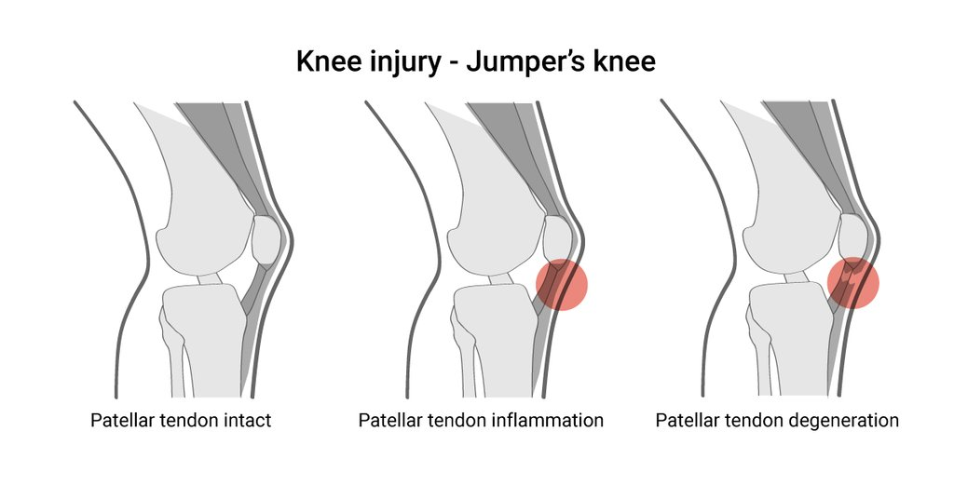
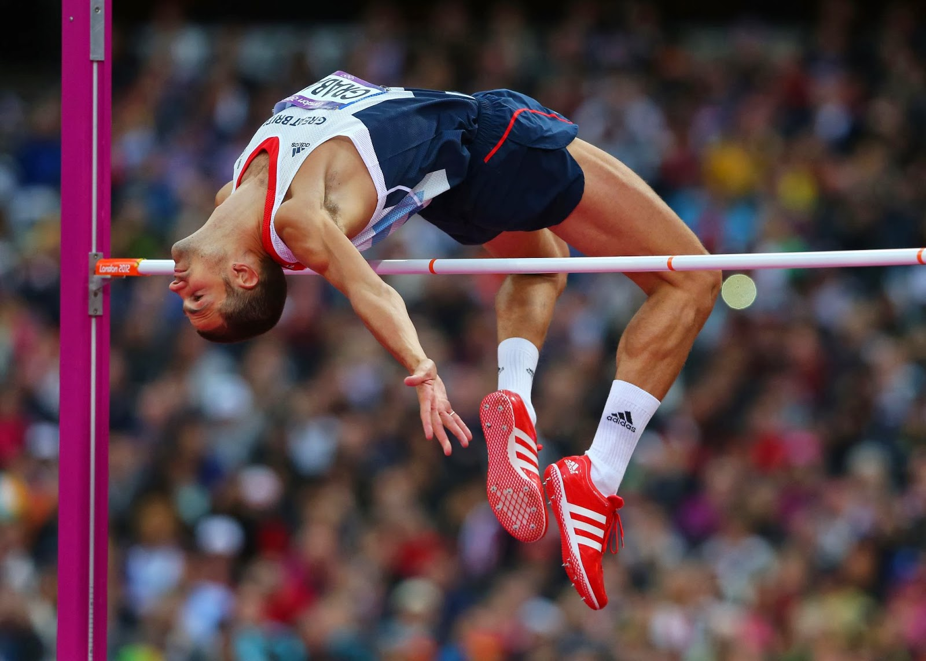
What is it?
Patellar Tendonitis is an injury to the tendon connecting the knee cap to the shin bone. It is usually caused by over use over long periods of time. This is most common in athletes who jump very frequently.
(High jumpers, volleyball players, basketball players, etc.)
https://www.enerskin.com/blogs/blogs/patellar-tendonitis-exercises-treatment
https://www.bing.com/images/search?view=detailV2&id=5AC8B8EE8226AA787157FC0577A889D10ACABDBD&thid=OIP.iDopFYg7dquaM1tlb2c0fwHaFS&mediaurl=http%3A%2F%2F4.bp.blogspot.com%2F-4tKfDJ6xoB0%2FUo-L2OcP9EI%2FAAAAAAAAAA4%2FAEBe4p-3Qsg%2Fs1600%2Fhigh%2Bjump.jpg&exph=1143&expw=1600&q=high+jump&selectedindex=10&ajaxhist=0&vt=0&eim=1,2,6

Slide 3
Causes
Increase in training frequency rapidly and suddenly.
training on rigid surfaces.
lack of stretching/ poor flexibility (tight quads, hip flexors, and hamstrings).
Poor foot posture.

Slide 4
Treatment
Taking blood thinners (Advil) promotes blood flow to the inflamed knee.
Various strengthening exercises.
Various stretches.
Properly warming up before exercise.
Taking a rest from utilization.
Icing after use.

Slide 5
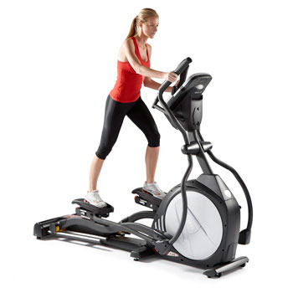
Warm up
Before strengthening and stretching, it is important to warm up the muscles in this region to have your blood pumping. Some examples are provided below.
Treadmill Jog 5-10 min
Bike for 5-10 min.
Elliptical 5-10 min.
blog.soletreadmills.com/wordpress/

Slide 6
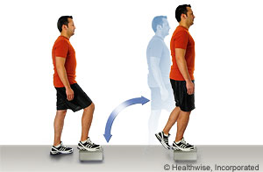
Strengthening
Step Up
Place small foot stool on ground next to a wall (use wall for stability if needed).
Step up on one leg, while keeping your back straight.
Bring opposite leg on to foot stool, then step down, one foot at a time.
Repeat 8 – 12 times.
https://myhealth.alberta.ca/Health/aftercareinformation/pages/conditions.aspx?hwid=bo1598

Slide 7
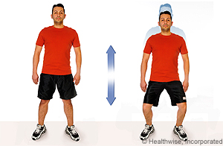
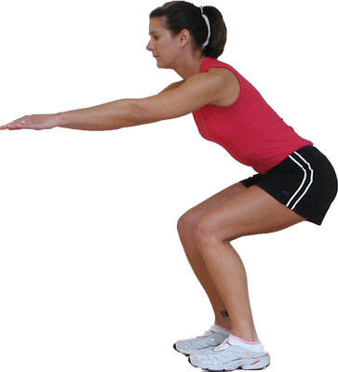
Strengthening
Half – Squat with knees and feet turned out to the side.
Stand with feet shoulder width apart, and turn feet 45 degrees laterally.
Squat down about half way, keep glutes tight, and keep the back straight going up and down.
Repeat 8 -12 times.
https://myhealth.alberta.ca/Health/aftercareinformation/pages/conditions.aspx?hwid=bo1598
https://www.bing.com/images/search?q=imgurl%3ahttp%3a%2f%2fcolorsnspirits.com%2fwp-content%2fuploads%2f2013%2f04%2fsquat-2.jpg&view=detailv2&iss=sbi&rtpu=%2fsearch%3fq%3dhalf+squat&form=IEQNAI&selectedindex=0&id=http%3A%2F%2Fcolorsnspirits.com%2Fwp-content%2Fuploads%2F2013%2F04%2Fsquat-2.jpg&mediaurl=http%3A%2F%2Fcolorsnspirits.com%2Fwp-content%2Fuploads%2F2013%2F04%2Fsquat-2.jpg&exph=0&expw=0&vt=2&sim=11

Slide 8
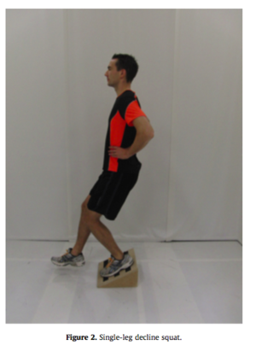
Strengthening
Single Leg Decline Squat
Stand on injured leg, and squat on said leg (on triangular platform).
Place hands on hips or in front of you to keep balance. Flex knee to about 60 degrees before coming back up.
Repeat 8-12 times.
https://www.raynersmale.com/blog/2015/10/27/understanding-patella-tendinopathy-management-of-jumpers-knee

Slide 9
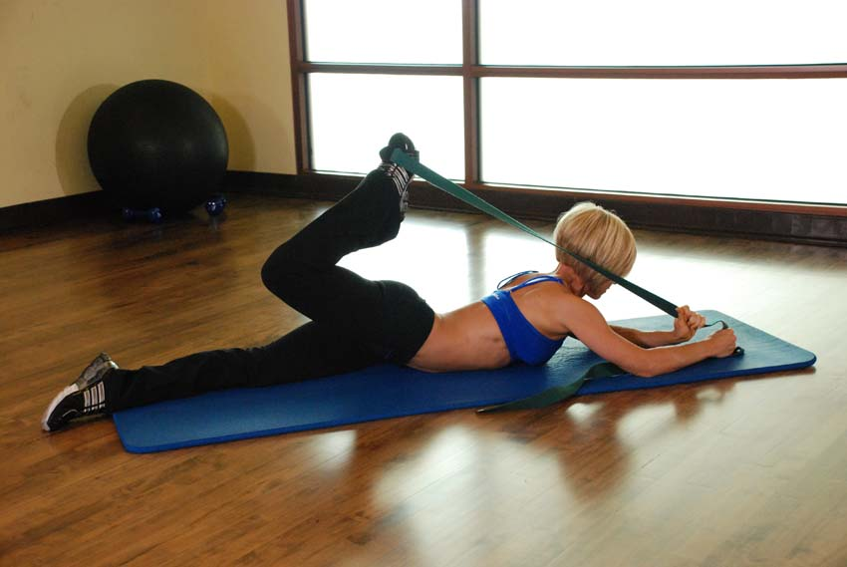
Stretches
Hip flexor stretch
Lay on the ground facing the ground.
Using a towel or band, pull ankle toward your head.
Hold for about 20 seconds.
Repeat 3 times.
healthybody.me/wp-content/uploads/2014/04/advanced-hip-flexor-exercise-with-band.jpg

Slide 10
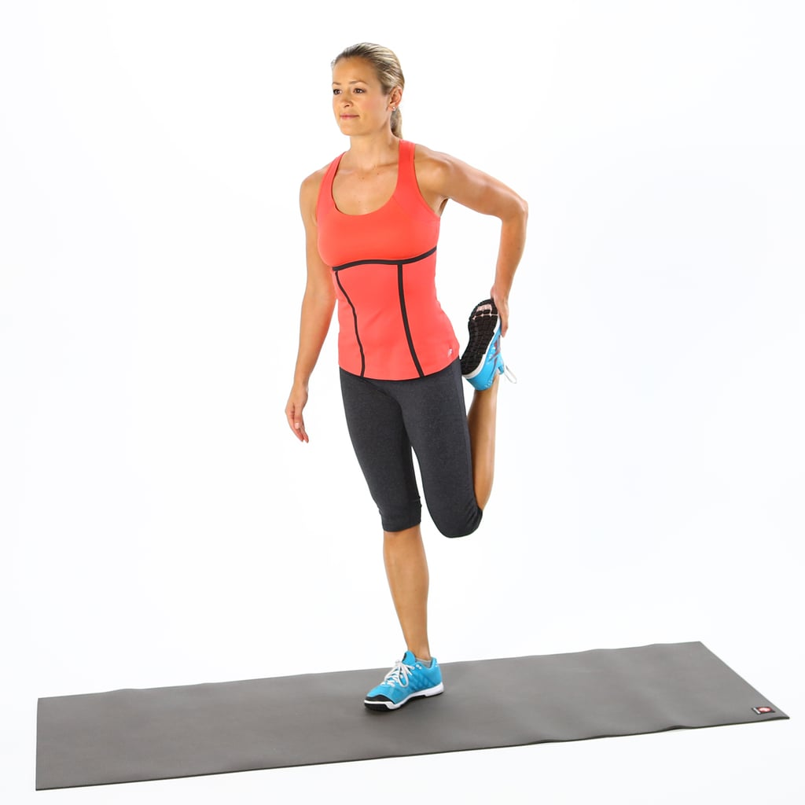
Stretches
Quadriceps stretch
While standing (next to a wall for support if needed), pull one foot back toward the glutes.
Hold for about 20 seconds.
Repeat 3 times.
https://media1.popsugar-assets.com/files/thumbor/NymzlPUHWB0Ezc8NG-q7vg5z57A/fit-in/1024x1024/filters:format_auto-!!-:strip_icc-!!-/2013/07/29/788/n/1922729/c407e6635886ed81_quad-stretch-stranding/i/Easy-Quad-Stretch.jpg

Slide 11
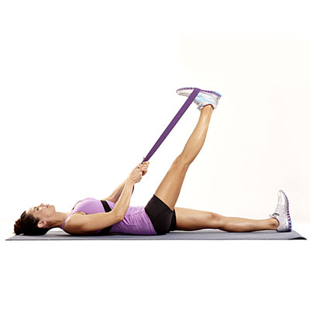
Stretches
Hamstring stretch
Lay on ground face up toward the ceiling.
Place towel or band around foot.
While keeping your leg straight, pull leg until about 90 degrees.
Hold for about 20 seconds.
Repeat 3 times.
https://healthnbodytips.org/wp-content/uploads/2015/10/hamstring-stretch.jpg

Slide 12
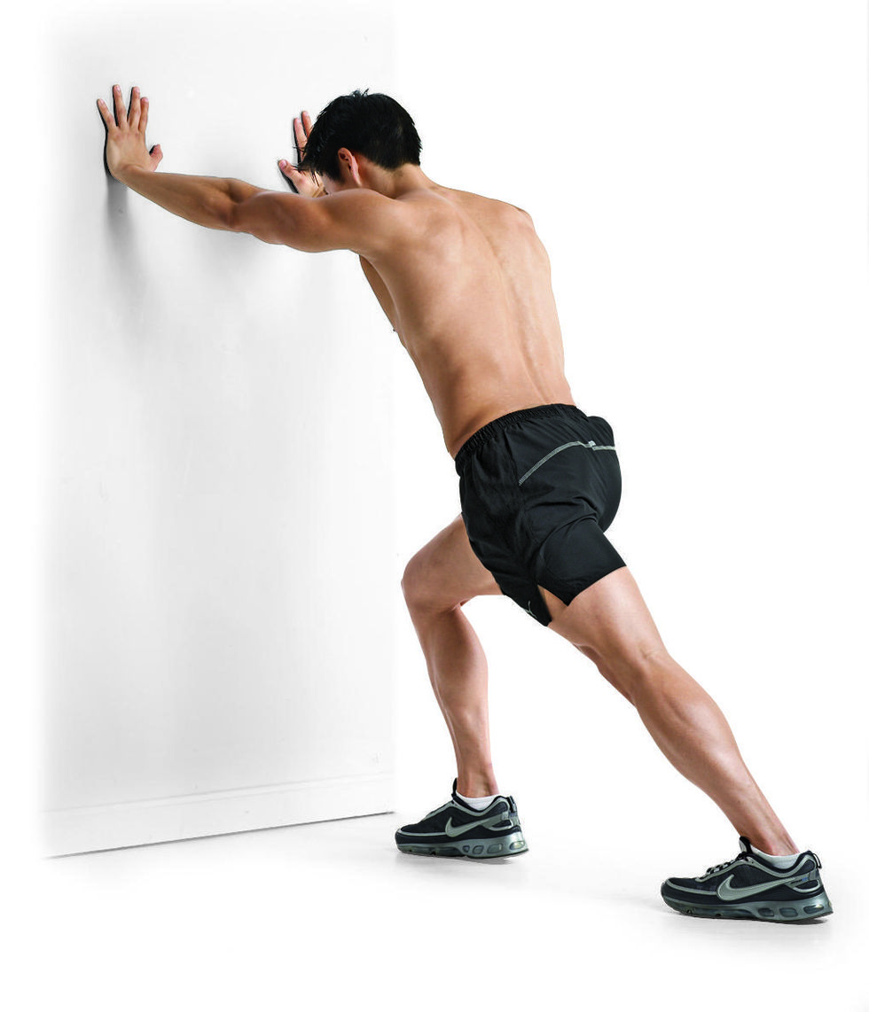
Stretches
Calf Stretch
Place hands against a wall.
Place one leg in front of the other for stability.
Straighten the back leg, and dorsiflex your back ankle.
Hold for about 20 seconds.
Repeat 3 times.
https://www.runnersworld.com/health-injuries/a20804932/how-to-take-care-of-your-calves/

